Slide 1
Algorithms
Lecture 0
Introduction & Contact Information

Slide 2
Introduction
Faculty Name : Prantik Paul (PNP)
Email : prantik.paul@bracu.ac.bd
Desk : 4M119
Consultation Hours: Sunday, Tuesday - 12:30PM - 2PM
Monday, Wednesday - 11AM - 12:30PM
Slack Channel Link : http://tiny.cc/cse221slackPNP
Resources Link : http://tiny.cc/cse221PNP

Slide 3
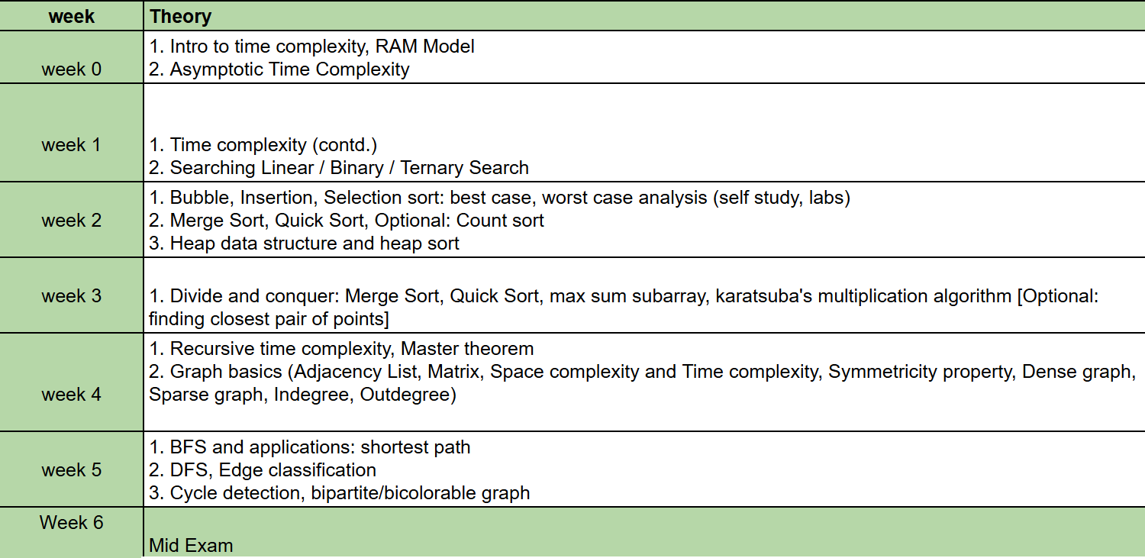
Topics we will cover

Slide 4
Topics we will cover
Time Complexity
Different Searches and Analysis
Different Sorts and Analysis
Divide and Conquer and Applications
Graph Basics
Graph Traversal and Applications

Slide 5
Evaluation
Mid Term Exam

Slide 6
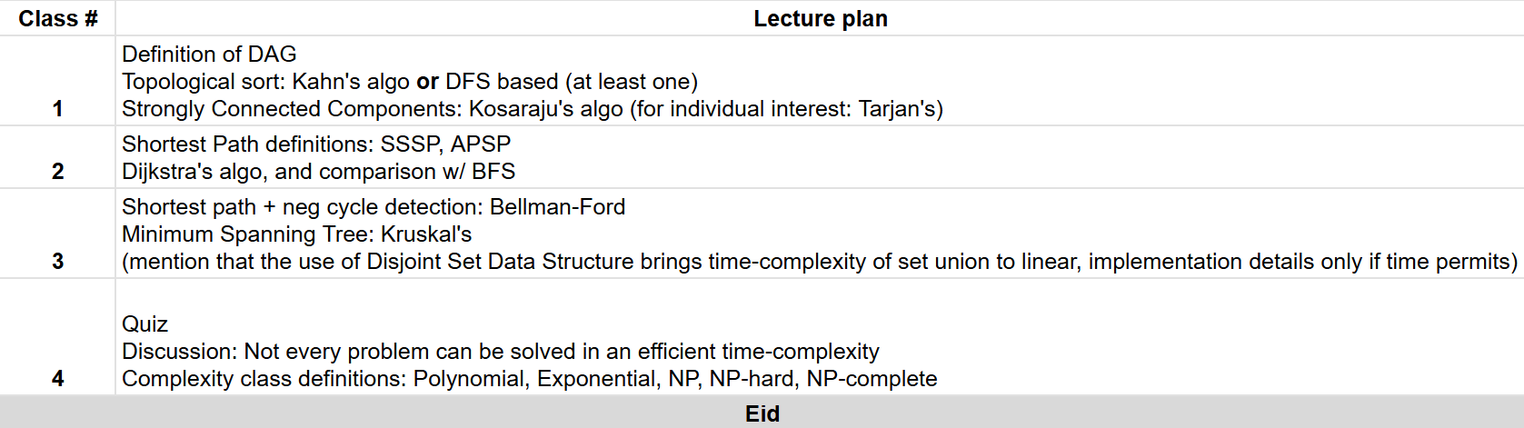
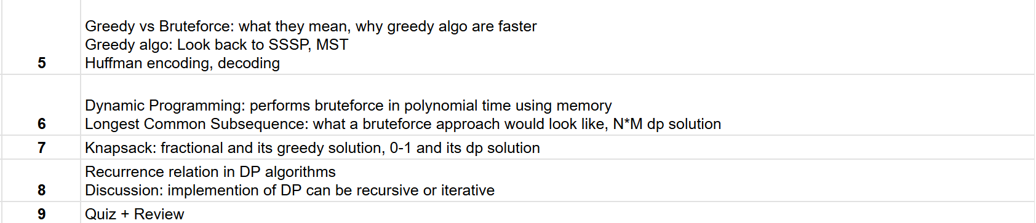
Topics we will cover

Slide 7
Topics we will cover
DAG and Applications
Topological sort and SCC
Shortest Path and MST
Shortest Path and MST
Greedy Algo and Applications
Dynamic Programming And Analysis

Slide 8
Evaluation
Final Exam

Slide 9
Evaluation
Quizzes
3 out of 4

Slide 10
Evaluation
Assignments

Slide 11
Marks Distribution
Class Performance: 5%
Quizzes: 15%
Assignment: 5%
Midterm: 20%
Final: 30%
Lab: 25%

Slide 12
Attendance Policy
Theory Attendance: 70%
Lab Attendance: 90%

